Slide 1

Plants
A web shop for plants

Slide 2
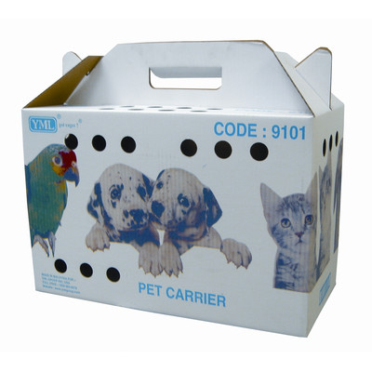

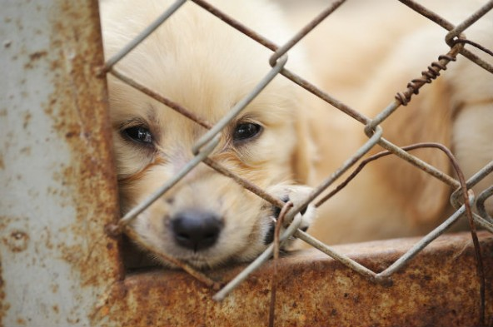
Tapping into new markets
Goal: Not just another web shop…
There are not too many web shops that sell living things – which got us thinking:
Web show idea #1: iAnimals (working title)
A web shop for exotic animals, which you can then choose from looking at the live webcam feeds that are installed in the cages:
Home delivered

Slide 3
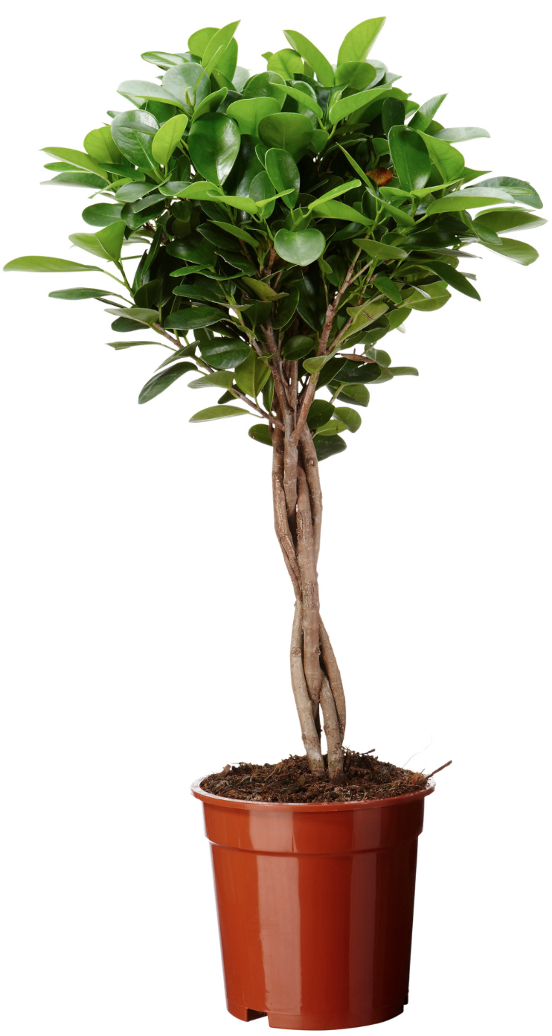
A more sensible approach
However: Storage costs are too high for animals and they can die in the distribution process…
We decided to go for a more realistic approach:
Plants are the ideal product for a web shop because
not everyone has a car, almost nobody has the right car to transport a plant
only few people have the know-how to buy the right plant for their home

Slide 4
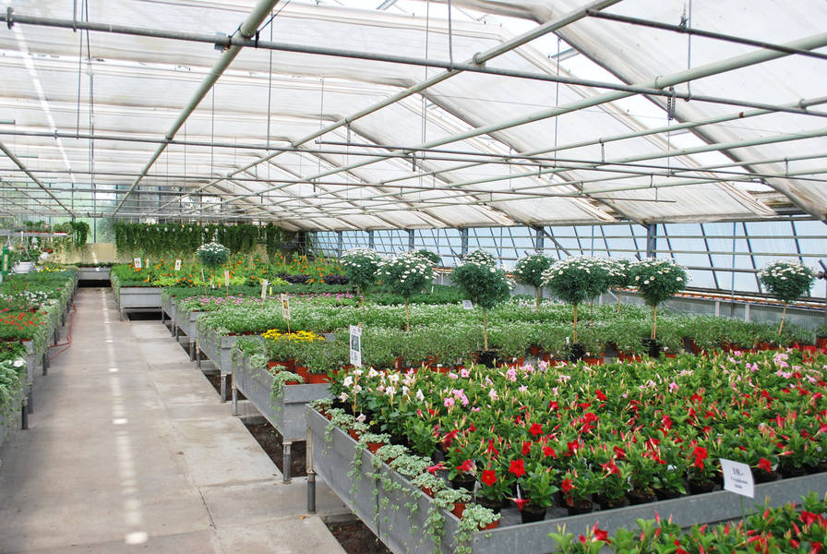
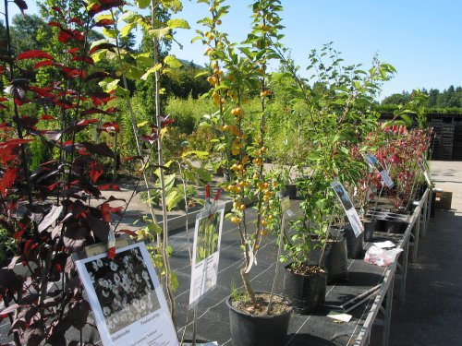
Business idea: plants
Business idea behind it
People only have a vague idea what a plant costs, so we can optimize our margin.
and we assume that people, who buy plants online buy them just to hipster up their apartment – plants will die soon and they will order new ones
Partnership with local greenhouses is possible, so we do not even have to store the plants ourselves

Slide 5
Features of our web shop
What our web shop offers: → Task Nummern rein
You can choose from a selection of plants, including their characteristics (such as pouring frequency, sunlight exposure etc.)
Select appropriate accessories (pots, fertilizer)
Register/Login with your user credentials
Search functionality, if you are looking for a specific plant
Whole order process with shopping cart
Appealing design to suggest professionalism
Administrator part with workflow tool
Plant wizard, who helps you choose the right plant for you

Slide 6
Work distribution among team

Slide 7
Technologies used
Technologies used:
Plants/Accessories/Users are stored in a database
Plants are linked with certain accessories
Search functionality is implemented by AJAX
We chose smarty as template
Now lets see how it looks…

Slide 8
Lessons learned

Slide 9
LIVE DEMO
Screenshot of plantshop

